Slide 1
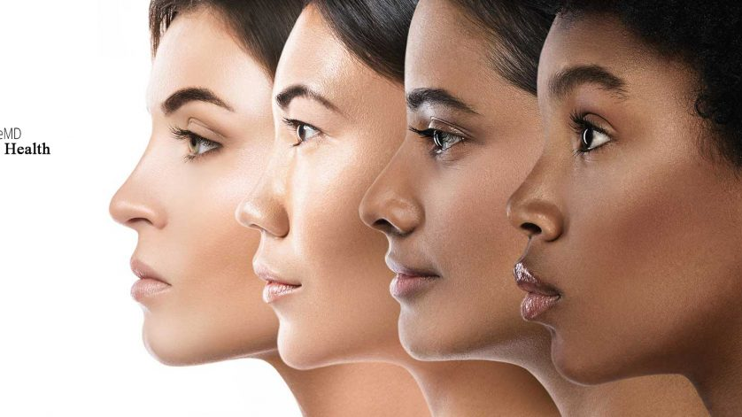
Skin Health

Slide 2
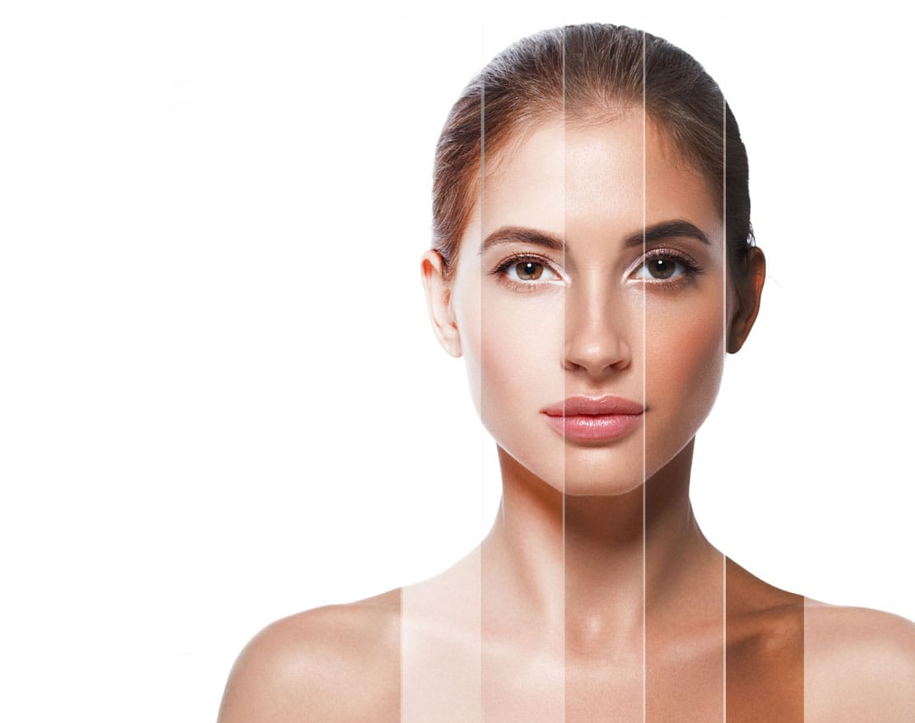
The concept of Skin health
Not just illness,
not just disease dermatology.
Let’s talk about wellness,
about desirable dermatology.
Diseases of skin will be a part of it.
So will be Desired skin. Flawless, healthy skin.
Let’s talk about Skin health as a whole.
360 degrees.

